Slide 1
Quantum Computing (MCS22) Deutsch-Jozsa Algorithm
Department of Computer Science and Engineering
M. Tech (CSE) – Second Semester (Term: June-Sept 2022)
Non CIE Component
Presented By:
Rajesh T
1MS21SCS17

Slide 2
Introduction ^{[1]}
The Deutsch-Jozsa algorithm is a deterministic quantum algorithm proposed by David Deutsch and Richard Jozsa in 1992.
In Deutsch-Jozsa Problem
We are given a black-box quantum computer (Oracle) that implements a function f : {0, 1}^{n} → {0, 1}
Input: n bit binary values. Output: 0 or 1
Promise: f is constant or balanced on all inputs
Problem: Determine whether f is constant or balanced

Slide 3
Classical Algorithm ^{[2]}
Let n = 3 Input: 3 bit binary
Possible Inputs: 2³ = 8
(0,0,0), (0,0,1), (0,1,0), (0,1,1), (1,0,0), (1,0,1), (1,1,0), (1,1,1)
Best case: f (0,0,0) = 1 and f (0,0,1) = 0 → Balanced
Worst case: f (0,0,0) = 1, f (0,0,1) = 1, f (0,1,0) = 1, f (0,1,1) = 1
for 5th query f (1,0,0) = 1 → Constant
f (1,0,0) = 0 → Balanced
Best case: 2 queries Worst case: 2^{n-1} + 1 queries

Slide 4
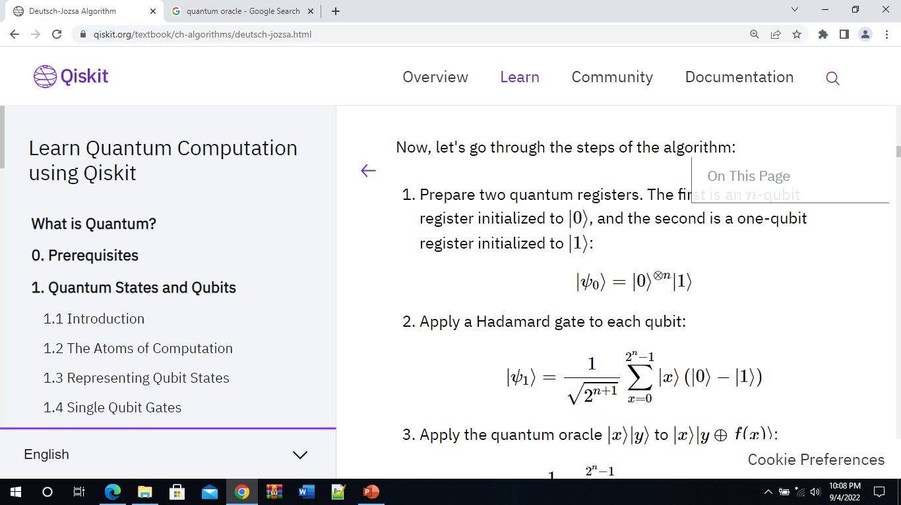
Quantum Algorithm ^{[3]}
Step 1: Prepare two quantum registers. The first is an n-qubit register initialized to |0⟩, and the second is a one-qubit register initialized to |1⟩
Step 2: Apply a Hadamard gate to each qubit

Slide 5
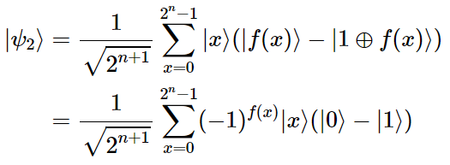
Step 3: Apply the quantum oracle |x⟩|y⟩ to |x⟩|y ⊕ f(x)⟩
since for each x, f(x) is either 0 or 1.

Slide 6
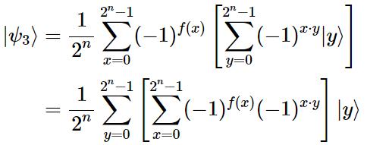
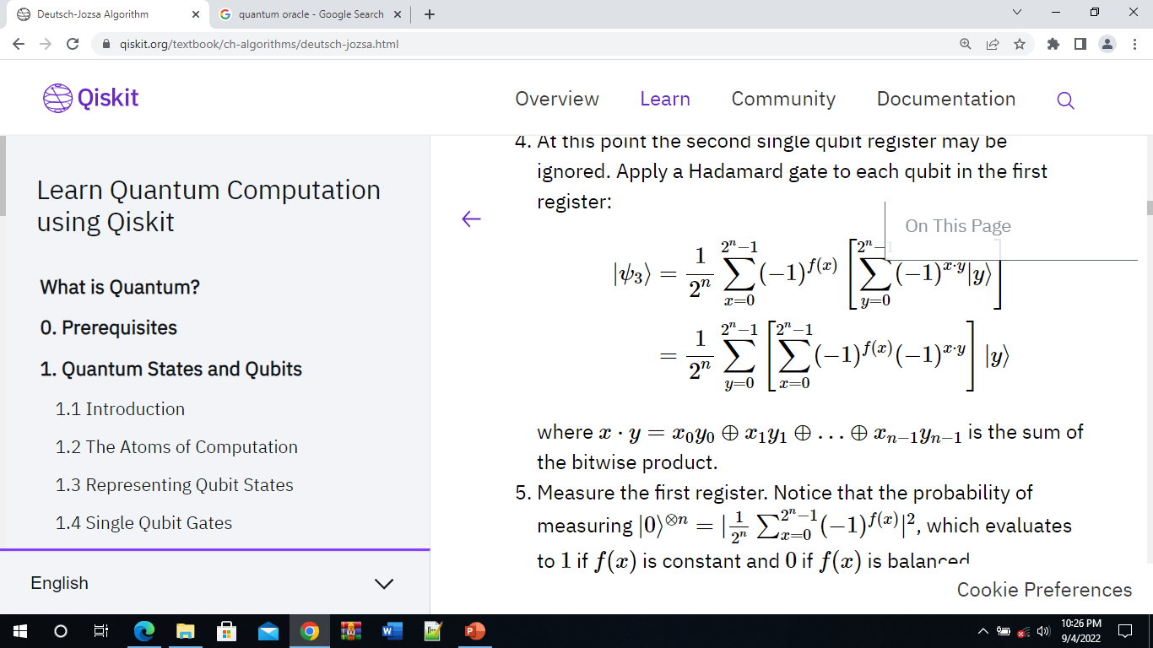
Step 4: Apply a Hadamard gate to each qubit in the first register
where is the sum of the bitwise product

Slide 7
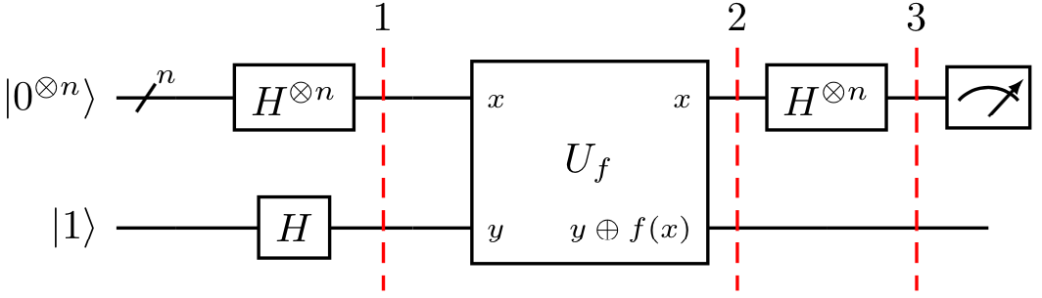
Step 5: Measure the first register. Notice that the probability of measuring which evaluates to 1 if f(x) is constant and 0 if f(x) is balanced

Slide 8


Question Hour
Consider a two-bit function f(x₀,x₁) = x₀ ⊕ x₁ such that
f(0,0) = 0
f(0,1) = 1
f(1,0) = 1
f(1,1) = 0
The corresponding phase oracle of this two-bit oracle is
Check if this oracle works as expected by taking a example state

Slide 9


Solution
1. The first register of two qubits is initialized to |00⟩ and the second register qubit to |1⟩
subscripts 0, 1, and 2 used to index the qubits
2. Apply Hadamard on all qubits

Slide 10
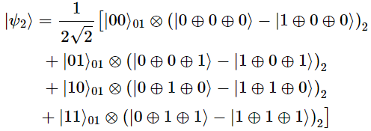
3. The oracle function can be implemented as
Q_{f} = CX₀₂CX₁₂

Slide 11
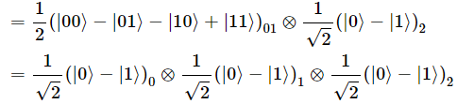

4. Simplifying this, we get the following
5. Apply Hadamard on the first register
6. Measuring the first two qubits will give the non-zero 11, indicating a balanced function

Slide 12
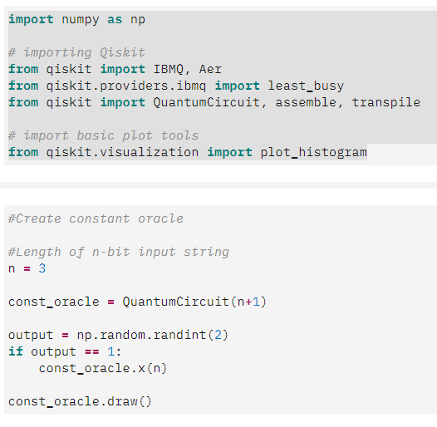
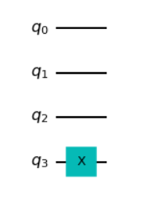
Qiskit Implementation
Constant Oracle

Slide 13
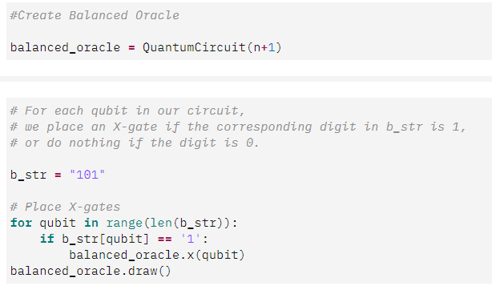
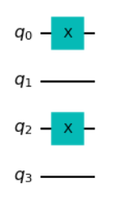
Balanced Oracle

Slide 14
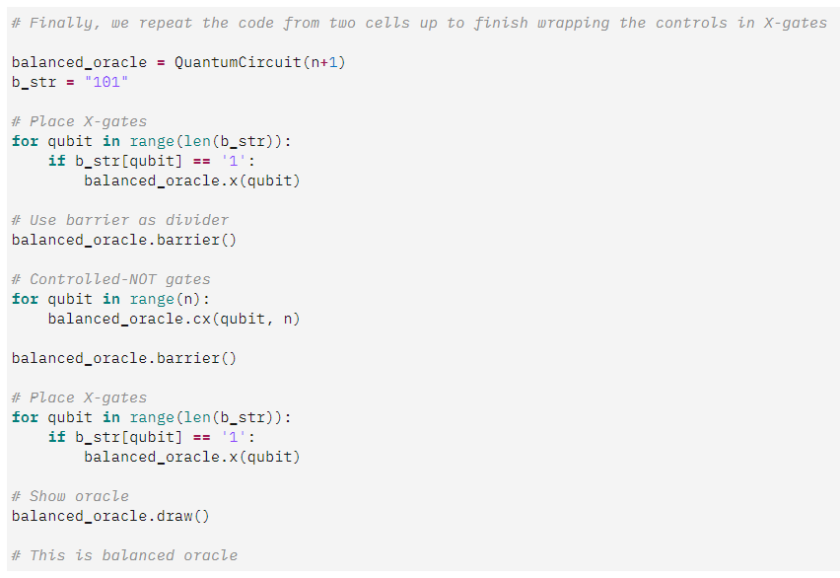
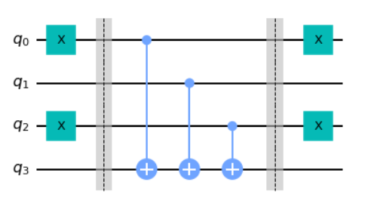

Slide 15
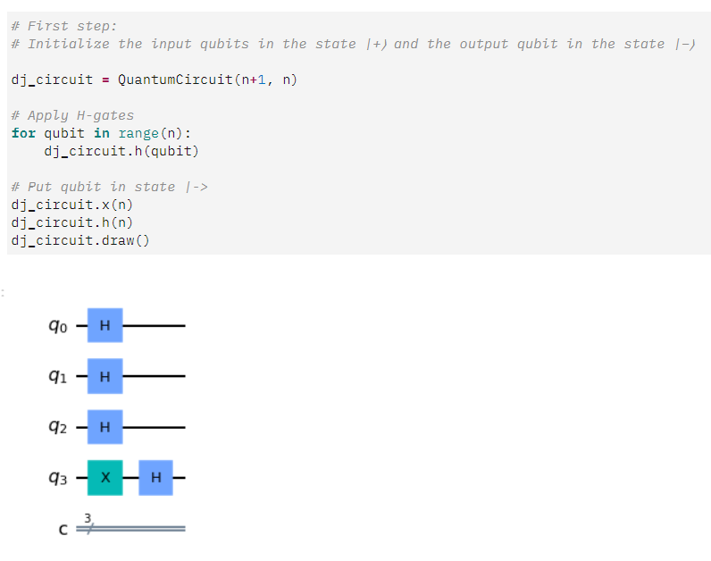

Slide 16
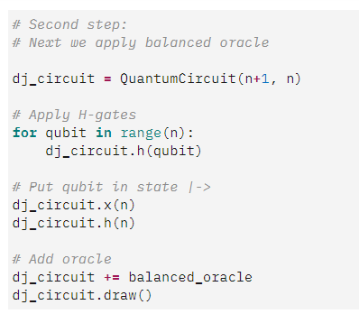
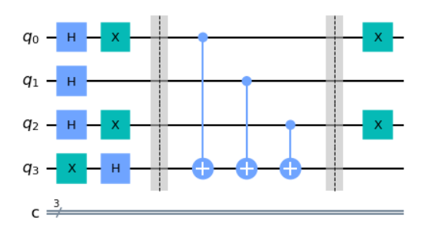

Slide 17
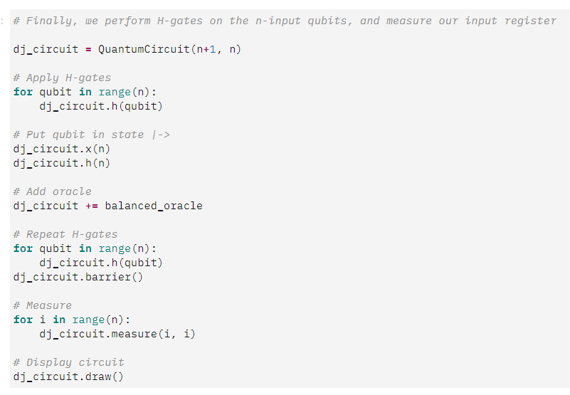
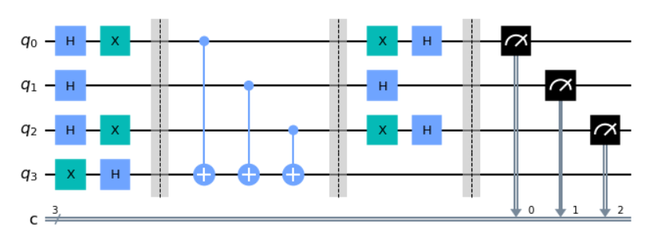

Slide 18
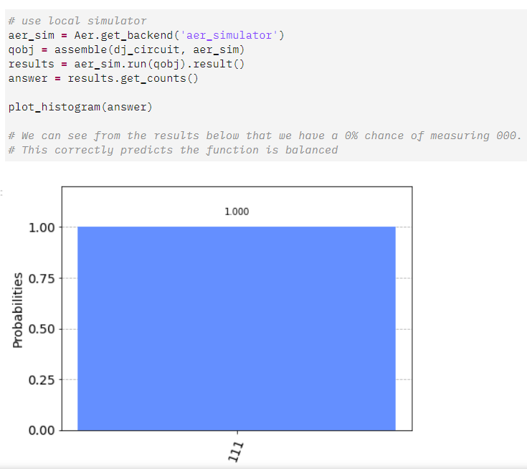

Slide 19
References
[1] https://en.wikipedia.org/wiki/Deutsch-Jozsa_algorithm
[2] Chris Bernhardt “Quantum Computing for Everyone”, The MIT Press, Cambridge, 2020
[3] https://qiskit.org/textbook/ch-algorithms/deutsch-jozsa.html

